Slide 1
LIF101 Lecture Topic (5) Tuesday 17 January 2023 Flow of genetic information, genetic code, mutations
https://www.youtube.com/watch?v=M4zHVRLXkgw&ab_channel=FrankGregorio
https://www.youtube.com/watch?v=zwibgNGe4aY&ab_channel=StatedClearly

Slide 2
Recaps
About DNA
DNA carries digitized information
Four digits are used to write genetic codes
Genetic information is encoded

Slide 3
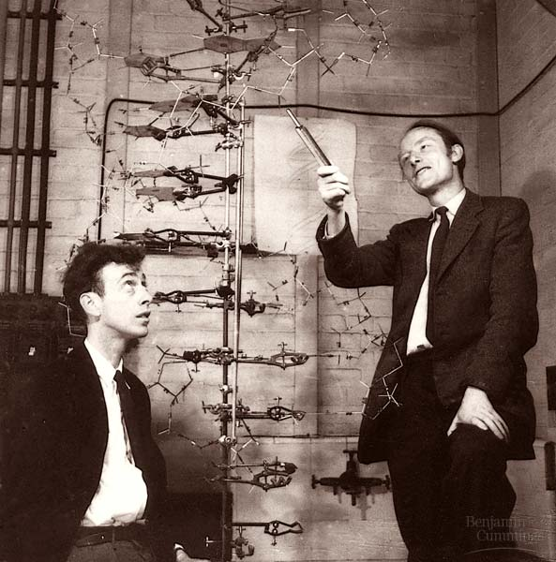
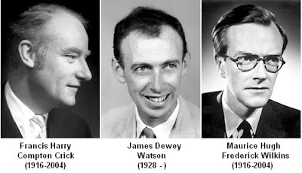
Watson and Crick proposed structure of DNA 1953
Journal Nature in its 171st volume on pages 737–738 ( 25 April 1953)
Recaps
Thus, to understand the nature of genetic information we need to understand the basic DNA structure and how information flows:
Within an individual.
From one generation to the other
Within a cell
1962 Nobel Prize in Physiology and Medicine

Slide 4
Chargaff’s Rule
Recaps
Adenine must pair with Thymine
Guanine must pair with Cytosine
Their amounts in a given DNA molecule will be about the same.
T
A
G
C

Slide 5
DNA Double Helix
Recaps
5
O
3
H-bonds
P
3
O
P
5
5
O
G
C
1
2
3
4
4
3
2
1
P
O
5
P
T
A
3
5
O
H-bonds
O
P
5
P
3

Slide 6
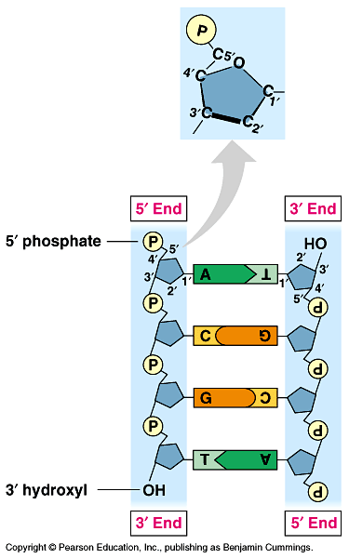
DNA strands run anti-parellel
Recaps
Mark the features of DNA that makes it ideal as a genetic materials
Sequence of nucleotides in DNA strands could store genetic information
Sequence in one strand serves as the template for the sequence in the other
´
´

Slide 7
Central dogma of Molecular biology
सिद्धांत
Nature of information flow
Flow of information Nucleic acid to protein
Flow of information: nucleic acid to nucleic acid
Replication
Transcription
Translation
DNA
RNA
protein
Reverse transcription
Why there is no loss of information during replication?
In subsequent lectures we will explore this flow of information the decoding process
How much of the information in DNA goes to RNA??

Slide 8
What guides flow of genetic information
Replication: synthesis of daughter DNA from parental DNA
Transcription: synthesis of RNA using DNA as the template
Translation: protein synthesis using mRNA molecules as the template
Reverse transcription: synthesis of DNA using RNA as the template

Slide 9
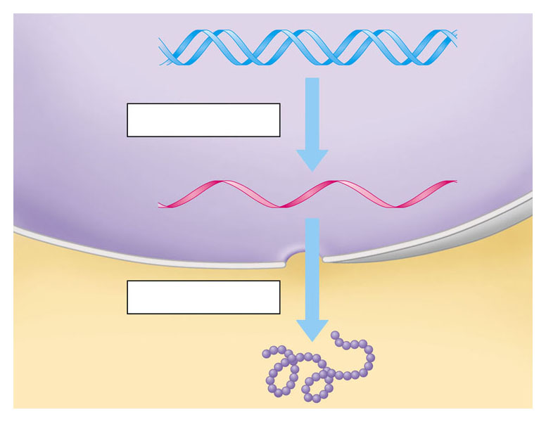
A gene is transcribed into RNA
which is then translated into the polypeptide
DNA
Transcription
RNA
Translation
Protein
From DNA to protein
https://www.youtube.com/watch?v=gG7uCskUOrA&ab_channel=yourgenome
https://www.youtube.com/watch?v=7Hk9jct2ozY&ab_channel=WEHImovies

Slide 10
FLOW OF GENETIC INFORMATION FROM DNA TO RNA TO PROTEIN
Gene (DNA) is a linear sequence of many nucleotides
DNA is transcribed into a linear sequence of RNA
RNA is translated into a linear sequence of amino acids – polypeptides (protein)
DNA
RNA
Protein
(polypeptide chain
Entire business of flow of genetic information thus depends on constructing (transferring information) one kind of polymer from another

Slide 11
Transcription – Step I
A C G T A T C G C G T A
T G C A T A G C G C A T
A C G T A T C G C G T A
T G C A T A G C G C A T
Template DNA Strands unzip locally

Slide 12
Transcription – Step II
A C G T A T C G C G T A
DNA
U G C A U A G C G C A U
mRNA
One of the DNA strands serve as a template and copied as mRNA (messenger RNA)
Transcription – Step III
A C G T A T C G C G T A
DNA
T G C A T A G C G C A T
U G C A U A G C G C A U
mRNA
mRNA is then releases

Slide 13
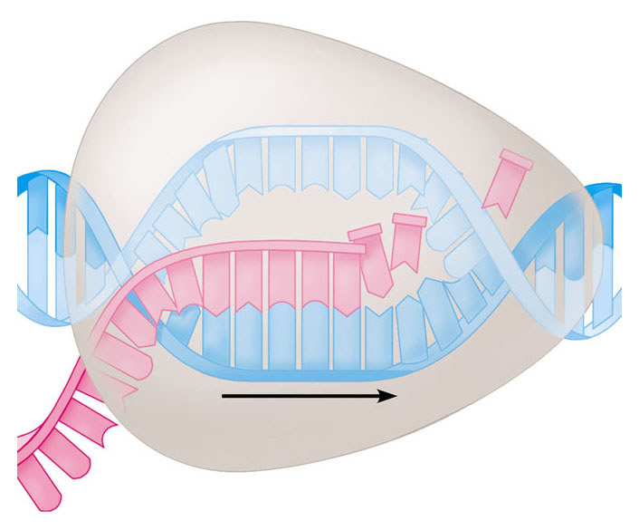
Transcription
RNA polymerase
RNA nucleotides
A
T
C
C
A
A
T
C
T
U
T
G
U
G
C
A
U
C
C
A
A
C
C
G
A
A
T
A
G
G
T
T
Direction of transcription
Template Strand of DNA
Newly made RNA

Slide 14
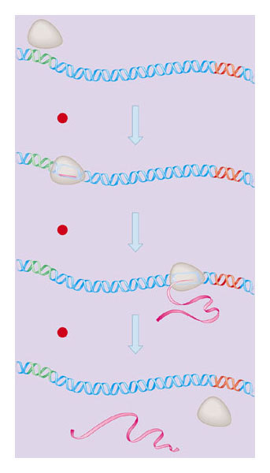
Transcription: Steps
RNA polymerase
DNA of gene
In the nucleus, the DNA helix unzips
And RNA nucleotides line up along one strand of the DNA, following the base pairing rules
As the single-stranded messenger RNA (mRNA) peels away from the gene
The DNA strands rejoin
Promoter
DNA
Terminator
DNA
1 Initiation
2 Elongation
Area shown
In Figure 10.9A
3 Termination
Growing
RNA
Completed RNA
RNA
polymerase

Slide 15
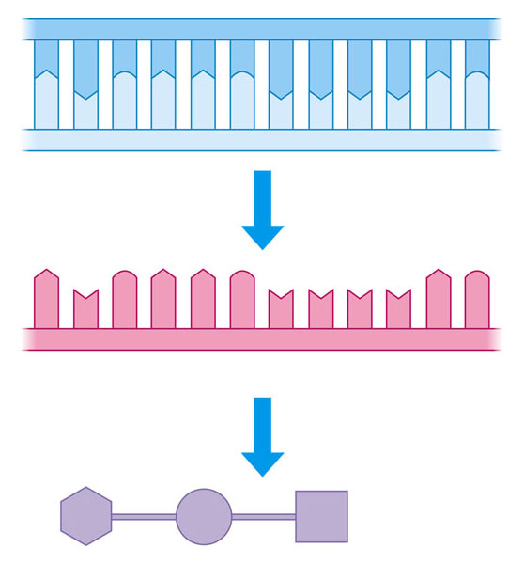
How does DNA/RNA code for protein?
Strand to be transcribed
T
A
C
T
T
C
A
A
A
A
T
C
DNA
A
T
G
A
A
G
T
T
T
T
A
G
Codon -
a sequence of nucleotides that codes for an amino acid
Transcription
A
U
G
A
A
G
U
U
U
U
A
G
RNA
Start condon
Stop condon
Translation
Polypeptide
Met
Lys
Phe
STEP III TRANSLATION

Slide 16
Genetic code : How can four nucleotides code for 20 amino acids?
If one nucleotide codes for one amino acid then a maximum of four amino acid could be coded
If two nucleotide code for one amino acid then a maximum of 16 amino acid could be coded
If three nucleotides code for one amino acid then a maximum of 64 codons can be generated, while the number of amino acids are only 20
4² = 16
4³ = 64

Slide 17
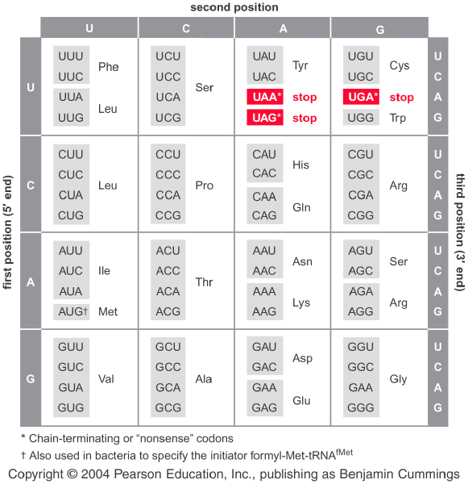
The dictionary of genetic code (64 potential codons) आनुवान्शिकी कोड
5’-→3’
A dictionary offers translation from one language to the other.

Slide 18
Hallmarks of genetic code
Triplet : three consecutive nucleotides code of one amino acid
Redundant or degenerate: meaning not unique (there are more than one codon for most amino acids)
Universal: All organisms bacteria to human use the same genetic codes/dictionary
Comma-less: meaning consecutive codons are readout into an amino acid sequence without gaps

Slide 19
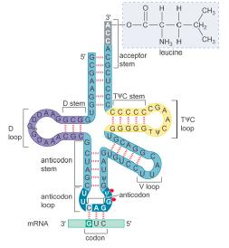
Key players in decoding the genetic message
DNA
Leucine
Messenger-RNA
Transfer RNA
Anti-codon
Amino acid
Codon

Slide 20
How genetic code is readout in the cell
A C G T A T C G C G T A
DNA
T G C A T A G C G C A T
3’ U G C A U A G C G C A U 5’
mRNA
3’
Amino acid
5’
Anti-Codon
5’
3’
tRNA
C A G
G U C
3’
5’
Codon

Slide 21
Many amino acids are specified by more than one codon-degeneracy or redundancy
Codons specifying the same amino acid are called synonyms
Connect the terms below about genetic codes:
redundancy, degeneracy and synonymous

Slide 22
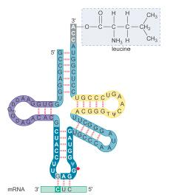
Codon-anticodon pairing of two tRNA Leu molecules
5’-→ 3’
5’-→ 3’
CUG
Codon
CUC
GAC
GAG
Anti- codon
3’-→ 5’
3’-→ 5’

Slide 23
Three codons direct chain termination
Three codons, UAA, UAG, and UGA signify chain termination.
They are not read by tRNAs but by proteins called release factors (RF1 and RF2 in bacteria and eRF1 in eukaryotes).
Three Rules reading codons
Codons are read in a 5’ to 3’ direction.
Codons are non-overlapping and the message contains no gaps.
The message is translated in a fixed reading frame which is set by the initiation codon.

Slide 24
Meaning and consequences of non-overlapping & comma-less reading of the triplet codons
Let’s consider a metaphor of a normal DNA sequence
FATCATATETHERAT
What is the problem here?
FATATATETHERAT
What is the consequence?

Slide 25
Mutation: a change in genetic code
1. Missense mutation: An alternation that changes a codon specific for one amino acid to a codon specific for another amino acid.
2. Nonsense or stop mutation: An alternation causing a change to a chain-termination codon.
3. Frame-shift mutation: Insertions or deletions of one or a small number of base pairs that alter the reading frame.

Slide 26
Experimental Results:
UUU codes for phenylalanine.
CCC codes for proline.
AAA codes for lysine.
The guanine residues in poly-G firmly hydrogen bond to each other and form multistranded triple helices that do not bind to ribosomes.

Slide 27
Codons Recognized
Amino Acids Incorporated
Codon Assignment
copolymer
(CU)” CUC|UCU|CUC… Leucine 5’-CUC-3’
Serine UCU
(UG)” UGU|GUG|UGU… Cystine UGU
Valine GUG
(AC)” ACA|CAC|ACA… Threonine ACA
Histidine CAC
(AG)” AGA|GAG|AGA… Arginine AGA
Glutamine GAG
(AUC)” AUC|AUC|AUC… Polyisoleucine 5’-AUC-3’

Slide 28
What Are Mutations?
Changes in the nucleotide sequence of DNA
May occur in somatic cells (aren’t passed to offspring), but could cause diseases, such as cancer
May occur in gametes (eggs & sperm) and be passed to offspring

Slide 29
Point mutation
Change of a single nucleotide
Includes the deletion, insertion, or substitution of ONE nucleotide in a gene
Types of Gene/Point Mutations
Substitutions
Insertions
Deletions
Frameshift
1. Missense mutation: An alternation that changes a codon specific for one amino acid to a codon specific for another amino acid.
2. Nonsense or stop mutation: An alternation causing a change to a chain-termination codon.
3. Frameshift mutation: Insertions or deletions of one or a small number of base pairs that alter the reading frame.

Slide 30
Problems and concept revision

Slide 31
Problems
Frameshift Mutation
Inserting or deleting one or more nucleotides
Changes the “reading frame” like changing a sentence
Proteins built incorrectly
THE FAT CAT ATE THE BIG RAT
Delete C
THE FAT ATA TET HEB IGR AT
Insert A
THE FAT ATA ATE THE BIG RAT
Frame shift mutation

Slide 32
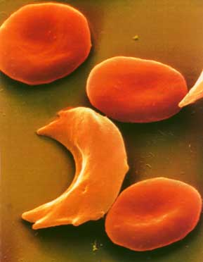
Example Point Mutation
Sickle Cell disease is the result of one nucleotide substitution
Occurs in the hemoglobin gene
The sixth position in the normal beta chain has glutamic acid, while sickle beta chain has valine. This is the sole difference between the two
Is Hb^{S} an allele of Hb^{β} ?

Slide 33
Consider a gene that specifies the structure of hemoglobin. Arrange the following events in the most likely sequence in which then following events might have occurred
a. Anemia is observed
b. The shape of the oxygen binding site is altered
c. An incorrect codon is transcribed into hemoglobin mRNA
d. The ovum (female gamete) receive a high radiation dose
e. An incorrect codon is generated in the DNA of the hemoglobin gene
f. A mother (an X-ray technician) accidentally steps in front of an operating X-ray generator
g. A child dies
h. The oxygen-transport capacity of the body is severely impaired
i. A wrong tRNA is attached
j. Nucleotide pair substitution occurs in the DNA of the gene for hemoglobin

Slide 34
Question
If an mRNA of human beta-globin gene is added to bacterial cell free extract then human β globin polypeptide is formed (translated)
What does this observation signify with respect to genetic code?

Slide 35
Home assignment
The amino acid sequence shown in the following table was obtained from the central region of a particular polypeptide chain in the wild type and several mutant bacterial strains
Codon
1 2 3 4 5 6 7 8 9
a. Wild type phe leu pro thr val thr thr arg trp
b. Mutant 1 phe leu his his gly asp asp thr val
c. Mutant 2 phe leu pro thr met thr thr arg trp
d. Mutant 3 phe leu pro thr val thr thr arg
e. Mutant 4 phe pro pro arg
f. Wild type phe leu pro ser val thr thr arg trp
For each mutant, identify the nature of the mutation

Slide 36
Home assignment
In mutant strain X of E. coli, a leucine tRNA that recognizes the codon 5’-CUG-3’ in normal cell has been so altered that is now recognizes the codon 5’-GUG-3’.
A missense mutation (lets call this mutation Y) that affects amino acid 10 of a particular protein is suppressed in mutant X cells (that is when the cells are mutant for both X and Y, which now appears wild type)
What mutational even has occurred in mutant X cells?
What amino acid would normally be present at position 10 of the protein (without the missense mutation)?
What amino acid is put in at position 10 if the missense mutations is not suppressed ?
What amino acid is put in at position 10 if the missense mutations is suppressed ?

Slide 37
Codon-anticodon pairing of two tRNA Leu molecules
5’-→ 3’
5’-→ 3’
CUG
Codon
CUC
GUG
GAC
GAG
Anti- codon
3’-→ 5’
3’-→ 5’

